Slide 1
CENG-232 Logic Design
Week 4
Combinational Logic Design

Slide 2
Combinational Logic
I₁
Combinational Logic
O₁
I_{m}
O_{n}
One or more digital signal inputs
One or more digital signal outputs
Outputs are only functions of current input values (ideal) plus logic propagation delays

Slide 3
Combinational Logic (Cont’d.)
Combinational logic has no memory!
Outputs are only function of current input combination
Nothing is known about past events
Repeating a sequence of inputs always gives the same output sequence
Sequential logic (covered later) does have memory
Repeating a sequence of inputs can result in an entirely different output sequence

Slide 4
Design Hierarchy
Large systems are usually too complex to design as a single entity
i.e., a 16 bit binary adder has 32 inputs and therefore there are 2^32 rows in the truth table!
System is usually partitioned into smaller parts which are further partitioned …
This defines a hierarchy of design from complex to simple;
“top to bottom”

Slide 5
Design Methodologies
There are two basic approaches to system design:
Top-down and Bottom-up.
Top-Down: start at the top system level and decompose into ever simpler subsystems and components
Bottom-Up: start with known low-level building blocks and put them together into increasing complex functions
Ideally either can be used to design a combinational system.

Slide 6
Concurrent Design
The practical approach is to combine the two
Basic top-down to provide proper decomposition and validation
BUT as you decompose functions, be aware of:
already existing and available components
component to component interface characteristics
reality - cost, size, weight, power, etc.
If done properly, you end up with a low-cost practical solution that works!

Slide 7
Rapid Prototyping and CAD
Rapid prototyping assumes we can built many different versions and see which ones work
Programmable logic is vital to this approach
Good development tools are also essential
Hardware description languages are the way we quickly specify and change our designs

Slide 8
Hardware Description Languages (HDLs)
Two main HDLs are being used today
VHDL
Verilog
Both are IEEE standards
Both allow us to specify logic designs as textual descriptions
BE AWARE - both look like a software procedure but are describing HARDWARE!
Concurrency!!!
We will use Verilog

Slide 9
Logic Synthesis
After writing the HDL program:
Logic synthesis translates the HDL to our hardware implementation
1st phase translates HDL to a generic, ideal logic description
logic expressions are generated and minimized
allows us to verify functional operation
2nd phase translates the design to the final physical device
complexity, speed, delays, power must be addressed
we can then simulate physical operation of device

Slide 10
Different Aspects of Digital Logic Implementation
Circuit Properties
logic representation
size
weight
speed
power
package
temperature
noise immunity
cost
Levels of Integration
SSI, MSI, LSI, VLSI
Circuit Technology
Digital Logic Families

Slide 11
Levels of Integration
Small Scale Integration (SSI)
<10 gates usually
Medium Scale Integration (MSI)
10 to 1000 gates
Decoders, adders, multiplexers
Registers and counters
Large Scale Integration (LSI)
Thousands of gates
processors, memory chips, PLDs
Very Large Scale Integration (VLSI)
Millions of gates in a single package
Large memory arrays, complex micro computer chips

Slide 12
Digital Logic Families
TTL : Transistor-transistor logic
In use for 50 years
Considered to be the standard
ECL: Emitter-coupled logic
Has advantage in high-speed operation
MOS: Metal-oxide semiconductor
Suitable for circuits that need high component density
CMOS: Complementary metal-oxide semiconductor
Low power consumption
Handheld computers, cameras, etc.
GaAs: Galium Arsenide
SiGe: Silicon-germanium

Slide 13
Technology Parameters
Fan-in
Fan-out
Noise margin
Propagation delay
Power dissipation

Slide 14
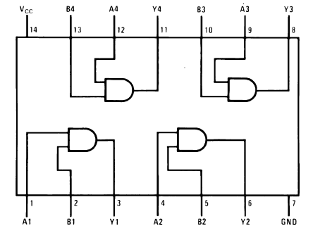
Fan-In
For logic gates, it’s the max number of inputs to a specific gate
Defined by gate design; usually limited to a max of 4 or 5
E.G. 74LS08 is a Quad, 2-input AND device
4 AND gates in package, each AND has 2 inputs
When you have more variables than your gate’s inputs
Cascade gates, transform function, etc.

Slide 15
Fan-Out
Fan-out is usually defined as the max number of “standard” logic gate inputs that can be connected to a logic gate output
Specifies the “drive” capability of an output
If an output is overloaded, other characteristics such as noise margin, rise & fall times are degraded
Different logic types are affected by “overload” in different ways

Slide 16
Noise Margin
V_{oh} = 2.8 v
V_{ih} = 2.4 v
V_{il} = 0.8 v
V_{ol} = 0.4 v
TTL
Logic
Levels
Noise margin high = 0.4 v
Transition region; neither Hi or Lo!
Noise margin low = 0.4 v
Noise Margin defines how much noise can be induced onto a logic signal and still be correctly recognized as a high or low level
Difference between output high or low level and input level that will recognized as high or low

Slide 17
Propagation Delay
Real devices do not have zero delay!
Propagation delays are measured from input change to output change (tPD)
Usually referenced to 50% point on transition
Gates usually have different delays for the output low to high (tLH) and high to low (tHL)
Best to design using the max of the two
Not all input changes show up at the output
Gate may not respond to a narrow pulse

Slide 18

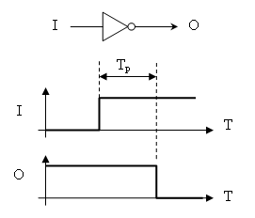
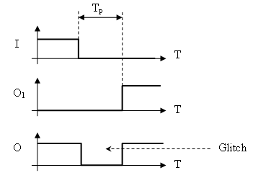
Propagation Delay and Glitches
From http://www.designcabana.com/knowledge/electrical/electronics/digital/propag/

Slide 19
Power Dissipation
The quantity of electrical power that is dissipated by the device as heat
Devices have temperature operating range that the device cannot exceed
Power dissipation is mainly static or dynamic depending on the logic type
TTL/ECL dissipation is mainly static and therefore independent of signal rate of change
CMOS dissipation is mainly dynamic and increases linearly with changing signals

Slide 20
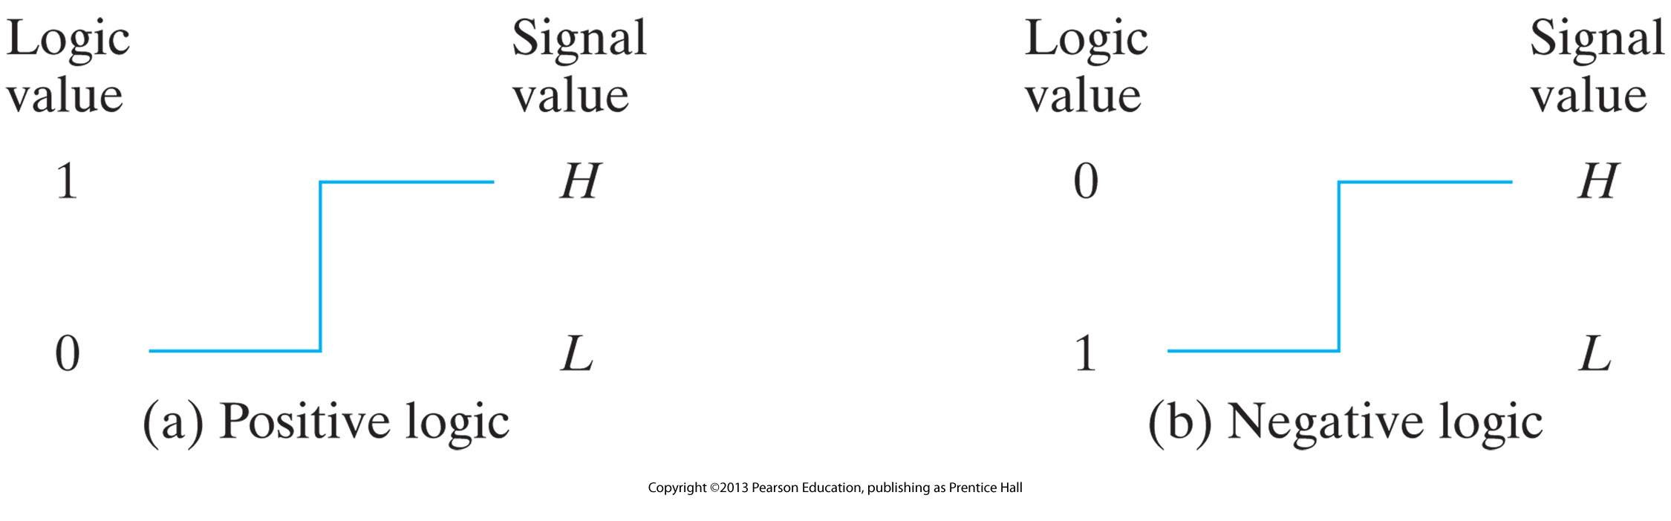
Positive and negative logic
We have 1 and 0 in Digital Logic
We have High Voltage and Low Voltage in the Digital Circuit
There are two ways to assign voltage states to logic states

Slide 21
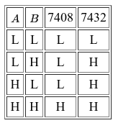
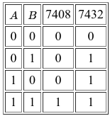
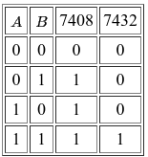
Positive and negative logic
Hardware manufacturers define their gates using signal values such as H and L.
The TTL chips with part numbers 7408 and 7432 generate outputs according to the function table below.
The same physical gate can operate either as a positive-logic AND gate or as a negative-logic OR gate.

Slide 22
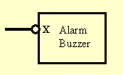
An example
This notation indicates that the alarm will be enabled when X is low.
From http://sce2.umkc.edu/csee/hieberm/281_new/lectures/basic-electrical-components/pos-neg-logic.html

Slide 23
Signal Active States and Bubbles
Primarily applies to control signals; used to denote when a condition is active or enabled
Symbol pins without bubbles denote active-1
Symbol pins with bubbles denote active-0
Active State - signal state (0 or 1) that indicates the assertion of some condition or action
Active-1 (active high) is when active state is logic 1
Active-0 (active low) is when active state is logic 0

Slide 24
Active States and Bubbles (Cont’d.)
Input asserted
active-1
Output asserted
active-0
Input asserted
active-0
Output asserted
active-1
Inverter (NOT) has two different forms

Slide 25
Alternative Symbols
The NOT example can be extended to all logic gates
Each logic gate has two equivalent symbols
The one we’ve seen so far for active-1 inputs
The alternate for active-0 inputs
In each case the gate operates the same
The only difference is how we interpret the values

Slide 26
AND Gate Alternate Symbol
X
F
F
T
T
Y
F
T
F
T
X·Y
F
F
F
T
X
0
0
1
1
Y
0
1
0
1
X·Y
0
0
0
1
Active-1
X
T
T
F
F
Y
T
F
T
F
X+Y
T
T
T
F
Active-0

Slide 27
OR Gate Alternate Symbol
X
F
F
T
T
Y
F
T
F
T
X+Y
F
T
T
T
X
0
0
1
1
Y
0
1
0
1
X+Y
0
1
1
1
Active-1
X
T
T
F
F
Y
T
F
T
F
X·Y
T
F
F
F
Active-0

Slide 28
Other Gate Alternative Symbols
Active-1 Active-0
NAND
NOR
XOR
XNOR

Slide 29
Signal Naming Conventions
The problem is how to distinguish between active-1 and active-0 signals.
Barring a signal name to designate active-0 is not recommended
Is A active-0 or NOT A??
Use suffix of ‘_0’; (i.e. A_0) after signal name
Use suffix of ‘_LO’ or ‘_L’
Use suffix of ‘_BAR’
No matter what you use, BE CONSISTENT!

Slide 30
Signal Naming Conventions
To denote an active-0 signal, we use one of the following naming conventions:
Suffix of ‘_0’; (i.e. A_0) after signal name
Suffix of ‘_LO’ or ‘_L’
Suffix of ‘_BAR’

Slide 31
Signal Naming (Cont’d.)
A_L
(active-0)
A
(active-1)
A
(active-1)
A_L
(active-0)
Active-0 signal naming and symbol bubbles require some thought to interpret properly

Slide 32
Naming and Alternate Symbols
TEMP1
TEMP1_L
TEMP2_L
HEAT
TEMP2
This is really a NOR gate
TEMP1_L
TEMP2_L
HEAT
Proper active-0 signal naming and usage of alternate symbols can clarify the circuit intent

Slide 33
Naming and Alternate Symbols
TEMP1_L
TEMP2_L
HEAT
Proper active-0 signal naming and usage of alternate symbols can clarify the circuit intent

Slide 34
Previously on CENG 232
Digital vs Analog
Binary Digital Systems
Represented physically by voltage, or ..
Boolean Algebra (Switching Algebra)
A way to express logic functions algebraically
Simplify Boolean functions
Algebraically, or using K-maps
To have economical implementations
Digital Gates that manipulates the signals to achieve functionality
Analyze the behavior of a logic circuit
Literal
Symbolic

Slide 35
Combinational Circuit Design

Slide 36
Design Methodology
We start with some form of a problem statement
Usually just text; ambiguous, poorly stated
We must produce a design representation
Minimized switching algebra expressions
The primary problem we have, is first to concisely define the true problem we are to solve
Define the “system” requirements

Slide 37
Design Methodology (Cont’d.)
Step 1 - Break down the problem statement
Identify system inputs and outputs
Extract the stated input-output relationship(s)
State the above as system (black-box) level requirements. BE PRECISE!
Step 2 - Perform initial system definition
Define interface variables and representation
If representation is not defined in problem statement, make preliminary assignment
Restate I/O relationship as algorithm, equation, simulation, etc.

Slide 38
Design Methodology (Cont’d.)
Step 3 - Translate relationships to logic representation
Construct truth table, generate S.A. expressions
This is the formal statement of the I/O relationship(s)
Step 4 - Generate minimal set of logic expressions
Rapid prototyping development tools
Karnaugh maps, Quine-McCluskey, etc.

Slide 39
Design Methodology (Cont’d.)
Step 5 - Implement and verify the design
Rapid prototyping (programmable logic) - target device and simulate timing behavior
Otherwise, draw schematic
Lots of ways to actually implement the equations
Must know what logic family you are to use.
Acid test is to build the circuit and test it
Must operate in real-world environment
Noise, temperature, other factors may cause problems

Slide 40
BCD to XS3 Example
BCD(X) to XS3(X)
BCD
digit
XS3
digit
Initial Statement: “Design a circuit to convert BCD to XS3.”
1) We need to restate and translate this to specific requirements
R1: The circuit shall input one BCD digit
R2: The circuit shall output one XS3 digit
R3: The XS3 output shall be the equivalent decimal value as the BCD input value

Slide 41
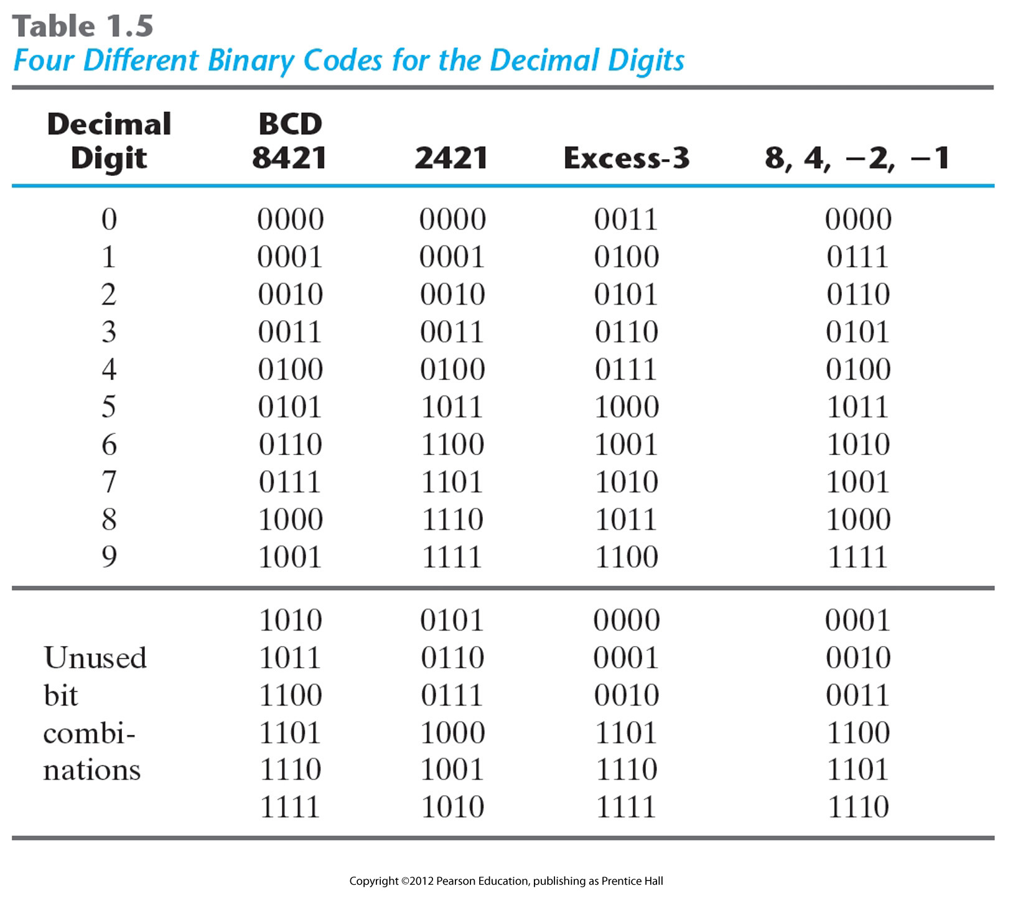
BCD to XS3 Example

Slide 42
BCD to XS3 Example (Cont’d.)
2) Now we need to define the interfaces in detail
We know that the input is one decimal digit in BCD representation, i.e. 4 bits, BCD := {b3, b2, b1, b0}
The output is one XS3 decimal digit, which is also 4 bits, i.e. XS3 := {x3, x2, x1, x0}
Usually, well known representations don’t need explicit definition; when in doubt, DEFINE IT!
3) Now we use a truth table to define the logical input/output relationship
Only 10 of 16 possible input combinations are valid
We’ll assume last 6 won’t occur; i.e. are don’t cares

Slide 43
BCD to XS3 Example (Cont’d.)
b₃
0
0
0
0
0
0
0
0
1
1
1
1
1
1
1
1
b₂
0
0
0
0
1
1
1
1
0
0
0
0
1
1
1
1
b₁
0
0
1
1
0
0
1
1
0
0
1
1
0
0
1
1
b₀
0
1
0
1
0
1
0
1
0
1
0
1
0
1
0
1
x₃
0
0
0
0
0
1
1
1
1
1
-
-
-
-
-
-
x₂
0
1
1
1
1
0
0
0
0
1
-
-
-
-
-
-
x₁
1
0
0
1
1
0
0
1
1
0
-
-
-
-
-
-
x₀
1
0
1
0
1
0
1
0
1
0
-
-
-
-
-
-
Note: Don’t cares
can work to our
advantage during
minimization; we
can assign either
0 or 1 as needed.

Slide 44
BCD to XS3 Example (Cont’d.)
4) Now we can generate the logical expressions for the outputs (canonical SofP form)

Slide 45
BCD to XS3 Example (Cont’d.)
The minimized equations are as follows:

Slide 46
BCD to XS3 Example (Cont’d.)
b0
b1
x3
b3
x2
b2
x1
x0

Slide 47
Technology Mapping
Translation of the “ideal” circuit design to actual hardware must account for the implementation method
ASICs (Application specific integrated circuit): full custom, standard cell, or gate arrays
Programmable logic: FPGAs or PLDs
Gate types, input configurations available
Vendors supply you with a set of logic gate design patterns known as a cell library
Defines implementation rules as well as gate types
CAD tools then use the provided library to map the ideal design to the physical implementation
Translates design to preferred logic types
Checks for problems; fan-out, propagation times exceeded

Slide 48
Verification
Design verification is much more difficult with VLSI ASICs than with SSI designs
Lots more signals and less accessibility
VLSI: Very-large-scale integration is the process of creating an integrated circuit by combining thousands of transistors into a single chip.
ASIC: Application specific integrated circuit
SSI: Small-scale integration. The early integrated circuits were SSI.

Slide 49
Verification
Ensuring that the final device actually works is mandatory and can also be hard to do
Must start with good requirements (validation)
It’s really bad to find out your design meets the stated requirements but it’s not what the customer wanted
Done at different stages of the development
Simulation used during the design capture and implementation mapping phase
Functional and parametric testing after device fabrication

